Slide 1


Aaron Ayitey
7/26/2023

Slide 2

Outline
Executive Summary
Introduction
Methodology
Results
Conclusion
Appendix

Slide 3
Executive Summary
Summary of methodologies
Summary of all results

Slide 4
Introduction
Project background and context
Problems you want to find answers

Slide 5

Section 1

Slide 6
Methodology
Executive Summary
Collected data from public SpaceX API and SpaceX Wikipedia page. Created labels column ‘class’ which classifies successful landings. Explored data using SQL, visualization, folium maps, and dashboards. Gathered relevant columns to be used as features. Changed all categorical variables to binary using one hot encoding. Standardized data and used GridSearchCV to find best parameters for machine learning models. Visualize accuracy score of all models.
Four machine learning models were produced: Logistic Regression, Support Vector Machine, Decision Tree Classifier, and K Nearest Neighbors. All produced similar results with accuracy rate of about 83.33%. All models over predicted successful landings. More data is needed for better model determination and accuracy.

Slide 7

Data Collection
Request (Space X APIs)
Filter data to only include Falcon 9 launches
Imputate missing PayloadMass values with mean
.JSON file + Lists(Launch Site, Booster Version, Payload Data)
Cast dictionary to a DataFrame
Json_normalize to DataFrame data from JSON
Dictionary relevant data

Slide 8
Data Collection – SpaceX API
Web Scrapping(Data Collection)
Request Wikipedia
html
Cast dictionary to DataFrame
Iterate through table cells to extract data to dictionary
BeautifulSoup
html5lib Parser
Find launch info html table
Create dictionary

Slide 9
Data Wrangling
Create a training label with landing outcomes where successful = 1 & failure = 0.
Outcome column has two components: ‘Mission Outcome’ ‘Landing Location’
New training label column ‘class’ with a value of 1 if ‘Mission Outcome’ is True and 0 otherwise. Value Mapping:
True ASDS, True RTLS, & True Ocean – set to -> 1
None None, False ASDS, None ASDS, False Ocean, False RTLS – set to -> 0

Slide 10
EDA with Data Visualization
Exploratory Data Analysis performed on variables Flight Number, Payload Mass, Launch Site, Orbit, Class and Year.
Plots Used:
Flight Number vs. Payload Mass, Flight Number vs. Launch Site, Payload Mass vs. Launch Site, Orbit vs. Success Rate, Flight Number vs. Orbit, Payload vs Orbit, and Success Yearly Trend
Scatter plots, line charts, and bar plots were used to compare relationships between variables to
decide if a relationship exists so that they could be used in training the machine learning model

Slide 11
EDA with SQL
Loaded data set into IBM DB2 Database.
Queried using SQL Python integration.
Queries were made to get a better understanding of the dataset.
Queried information about launch site names, mission outcomes, various pay load sizes of customers and booster versions, and landing outcomes

Slide 12
Build an Interactive Map with Folium
Folium maps mark Launch Sites, successful and unsuccessful landings, and a proximity example to key locations: Railway, Highway, Coast, and City.
This allows us to understand why launch sites may be located where they are. Also visualizes successful landings relative to location.

Slide 13
Build a Dashboard with Plotly Dash
Dashboard includes a pie chart and a scatter plot.
Pie chart can be selected to show distribution of successful landings across all launch sites and can be selected to show individual launch site success rates.
Scatter plot takes two inputs: All sites or individual site and payload mass on a slider between 0 and 10000 kg.
The pie chart is used to visualize launch site success rate.
The scatter plot can help us see how success varies across launch sites, payload mass, and
booster version category.

Slide 14
Predictive Analysis (Classification)
Split label column
Score models on
Confusion Matrix
‘Class’ from dataset
split test set
for all models
Fit and Transform
Use GridSearchCV
Features using
on LogReg, SVM,
Barplot to compare scores of models
Standard Scaler
Decision Tree, and
KNN models
Train_test_split
GridSearchCV
data
(cv=10) to find optimal parameters

Slide 15
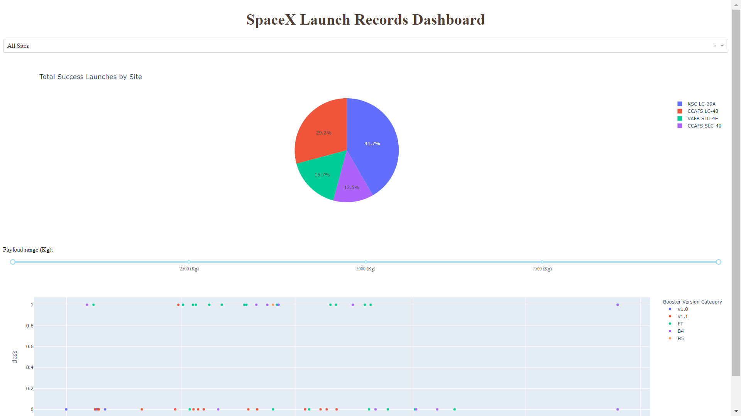
Results
This is a preview of the Plotly dashboard. The following sides will show the results of EDA with visualization, EDA with SQL, Interactive Map with Folium, and finally the results of our model with about 83% accuracy.

Slide 16

Section 2

Slide 17
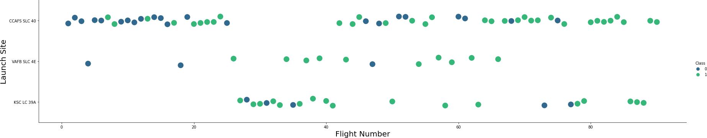
Flight Number vs. Launch Site
Green indicates successful launch; Purple indicates unsuccessful launch.
Graphic suggests an increase in success rate over time (indicated in Flight Number). Likely a big breakthrough around flight 20 which significantly increased success rate. CCAFS appears to be the main launch site as it has the most volume.

Slide 18
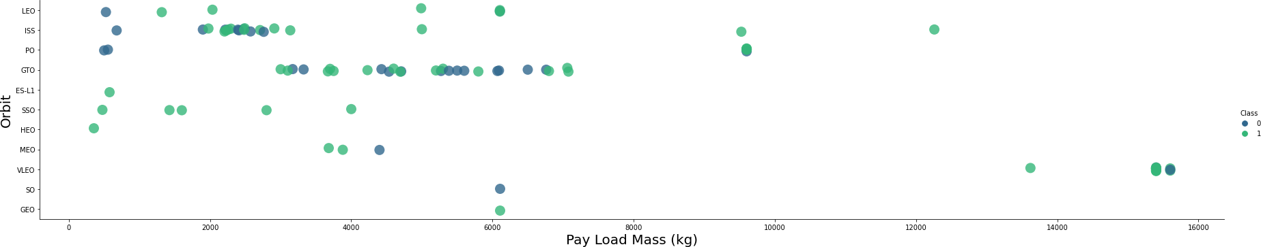
Payload vs. Launch Site
Green indicates successful launch; Purple indicates unsuccessful launch.
Payload mass seems to correlate with orbit
LEO and SSO seem to have relatively low payload mass
The other most successful orbit VLEO only has payload mass values in the higher end of the range

Slide 19
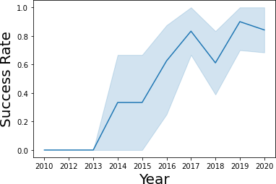
Success Rate vs. Orbit Type
95% confidence interval (light blue shading)
Success generally increases over time since 2013 with a slight dip in 2018
Success in recent years at around 80%

Slide 20
Launch Success Yearly Trend
Show a line chart of yearly average success rate
Show the screenshot of the scatter plot with explanations

Slide 21
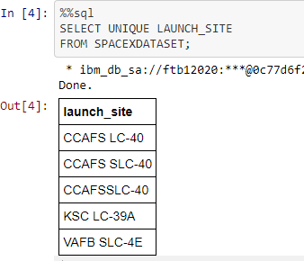
All Launch Site Names
Query unique launch site names from database.
CCAFS SLC-40 and CCAFSSLC-40 likely all represent the same
launch site with data entry errors.
CCAFS LC-40 was the previous name. Likely only 3 unique launch_site values: CCAFS SLC-40, KSC LC-39A, VAFB SLC-4E

Slide 22

Launch Site Names Begin with 'CCA'
Find 5 records where launch sites begin with `CCA`
Present your query result with a short explanation here

Slide 23
Total Payload Mass
Calculate the total payload carried by boosters from NASA
Present your query result with a short explanation here

Slide 24

Average Payload Mass by F9 v1.1

Slide 25

First Successful Ground Landing Date

Slide 26

Successful Drone Ship Landing with Payload between 4000 and 6000

Slide 27
Total Number of Successful and Failure Mission Outcomes
Calculate the total number of successful and failure mission outcomes
Present your query result with a short explanation here

Slide 28
Boosters Carried Maximum Payload
List the names of the booster which have carried the maximum payload mass
Present your query result with a short explanation here

Slide 29
2015 Launch Records
List the failed landing_outcomes in drone ship, their booster versions, and launch site names for in year 2015
Present your query result with a short explanation here

Slide 30
Rank Landing Outcomes Between 2010-06-04 and 2017-03-20
Rank the count of landing outcomes (such as Failure (drone ship) or Success (ground pad)) between the date 2010-06-04 and 2017-03-20, in descending order
Present your query result with a short explanation here

Slide 31

Section 3

Slide 32

<Folium Map Screenshot 1>

Slide 33

<Folium Map Screenshot 2>

Slide 34
<Folium Map Screenshot 3>
Replace <Folium map screenshot 3> title with an appropriate title
Explore the generated folium map and show the screenshot of a selected launch site to its proximities such as railway, highway, coastline, with distance calculated and displayed
Explain the important elements and findings on the screenshot

Slide 35

Section 4

Slide 36
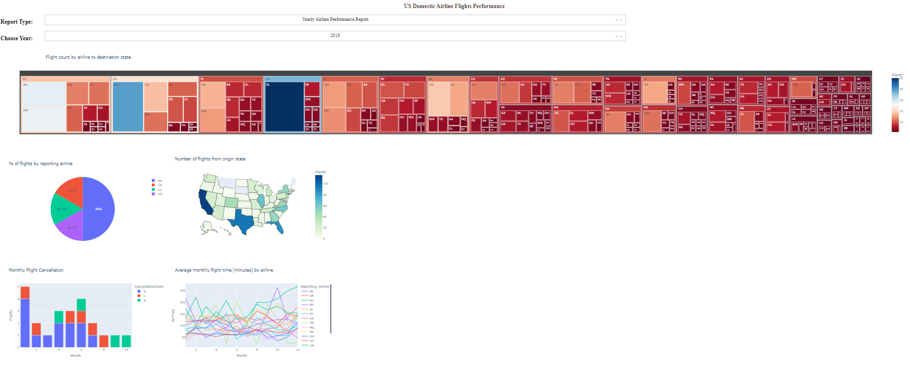
<Dashboard Screenshot 1>

Slide 37
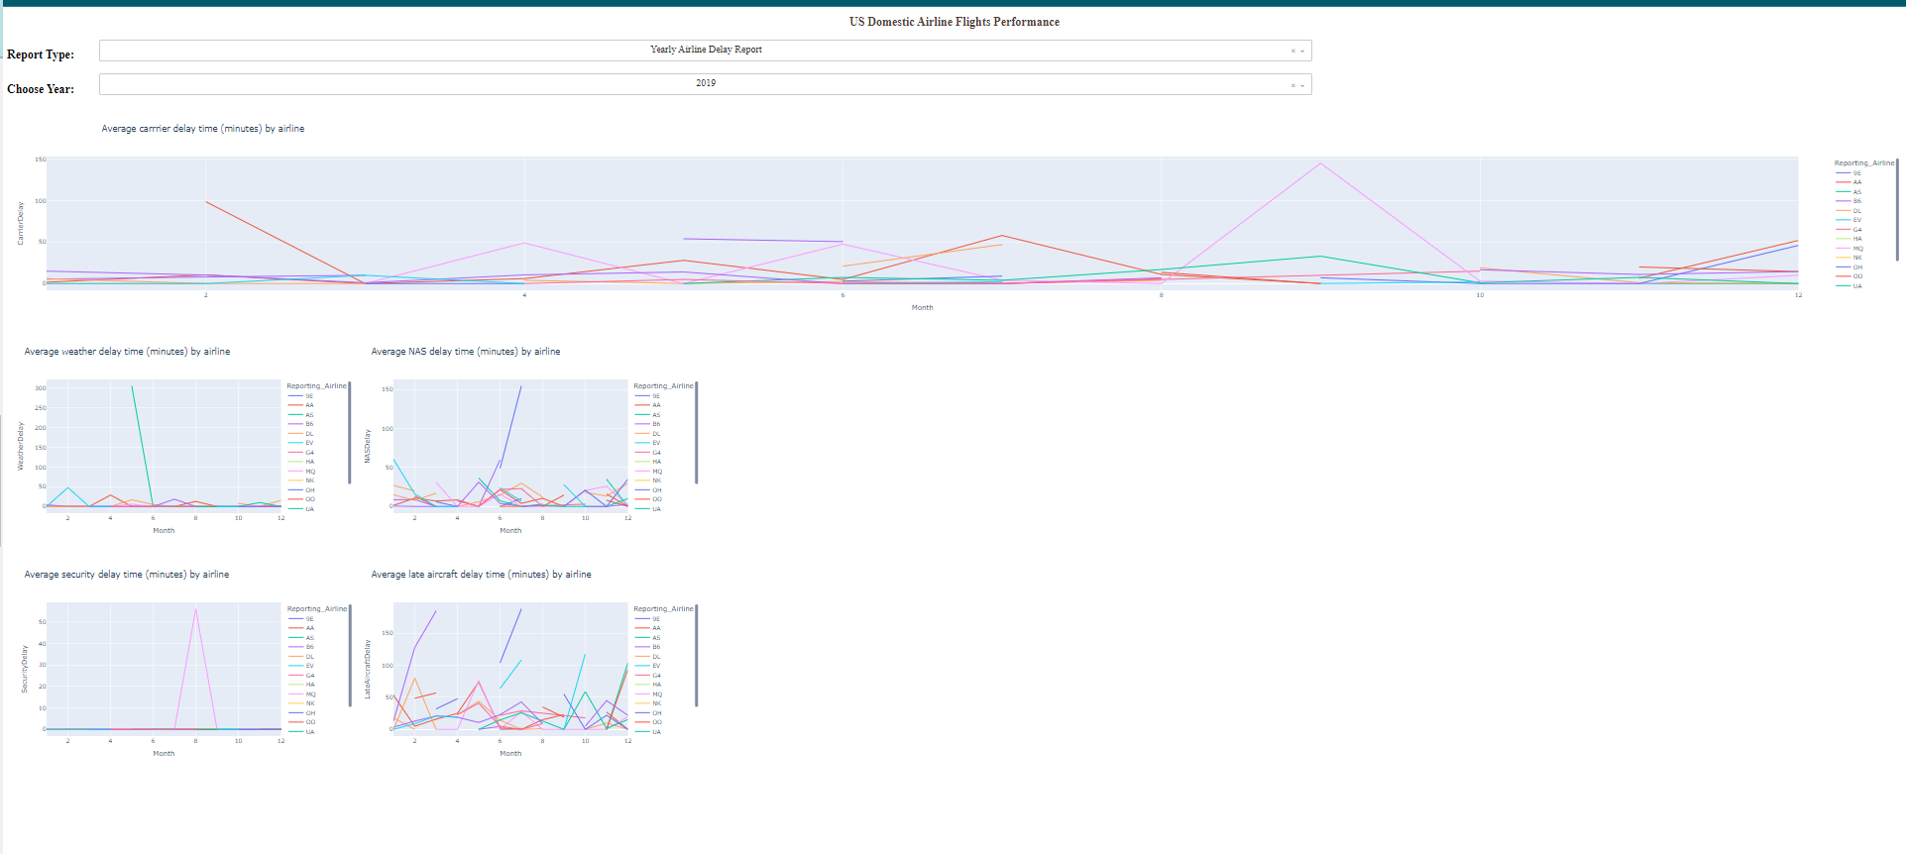
<Dashboard Screenshot 2>

Slide 38
<Dashboard Screenshot 3>
Replace <Dashboard screenshot 3> title with an appropriate title
Show screenshots of Payload vs. Launch Outcome scatter plot for all sites, with different payload selected in the range slider
Explain the important elements and findings on the screenshot, such as which payload range or booster version have the largest success rate, etc.

Slide 39

Section 5

Slide 40
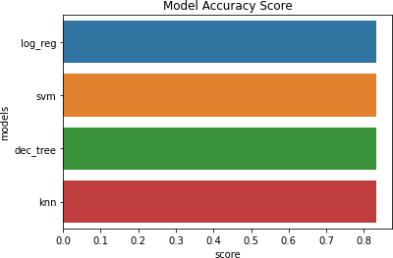
Classification Accuracy
All models had virtually the same accuracy on the test set at 83.33% accuracy. It should be noted that test size is small at only sample size of 18.
This can cause large variance in accuracy results, such as those in Decision Tree Classifier model in repeated runs.
We likely need more data to determine the best model.

Slide 41

Confusion Matrix
Since all models performed the same for the test set, the confusion matrix is the same across all models. The models predicted 12 successful landings when the true label was successful landing.
The models predicted 3 unsuccessful landings when the true label was unsuccessful landing.
The models predicted 3 successful landings when the true label was unsuccessful landings (false positives). Our models over predict successful landings.

Slide 42
Conclusions
Our task: to develop a machine learning model for Space Y who wants to bid against SpaceX
The goal of model is to predict when Stage 1 will successfully land to save ~$100 million USD
Used data from a public SpaceX API and web scraping SpaceX Wikipedia page
Created data labels and stored data into a DB2 SQL database
Created a dashboard for visualization
We created a machine learning model with an accuracy of 83%
Allon Mask of SpaceY can use this model to predict with relatively high accuracy whether a launch will have a successful Stage 1 landing before launch to determine whether the launch should be made or not
If possible more data should be collected to better determine the best machine learning model and improve accuracy

Slide 43
Appendix
Instructors:
Instructors: Rav Ahuja, Alex Aklson, Aije Egwaikhide, Svetlana Levitan, Romeo Kienzler, Polong Lin, Joseph Santarcangelo, Azim Hirjani, Hima Vasudevan, Saishruthi Swaminathan, Saeed Aghabozorgi, Yan Luo

Slide 44


